Slide 1

Nyaya Sahayak
Your Personal AI Legal Consultant – Fast, Private, & Accurate
TEAM E
CHANDREYI GHOSH
ROCHIT R
HIDA FATHIMA P H

Slide 2

The Problem Statement
LEGAL COMPLEXITY IS A BARRIER TO GROWTH
Core Issues:
High Cost: Traditional legal review costs ₹5,000–₹15,000 per hour.
The "Legalese" Wall: SMEs struggle to understand complex clauses (Indemnity, Liability).
Hidden Risks: Unfavorable terms buried in long PDFs lead to financial loss.
Indian Context: Lack of support for Hindi/English bilingual contracts and specific Indian Labor Laws.

Slide 3
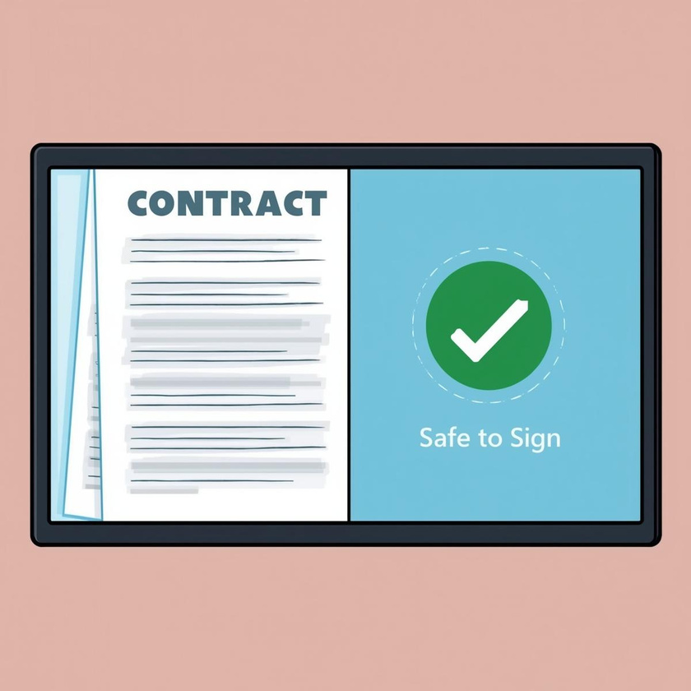
Our Solution
NYAYA SAHAYAK – LEGAL AID
Value Proposition:
Instant Analysis: Processes contracts in < 2 minutes.
Risk Scoring: A quantified 0-100 "Health Score" for every document.
Plain Language: Translates legal jargon into simple business English/Hindi.
Actionable Advice: Doesn't just find problems; suggests Safer Alternatives.

Slide 4
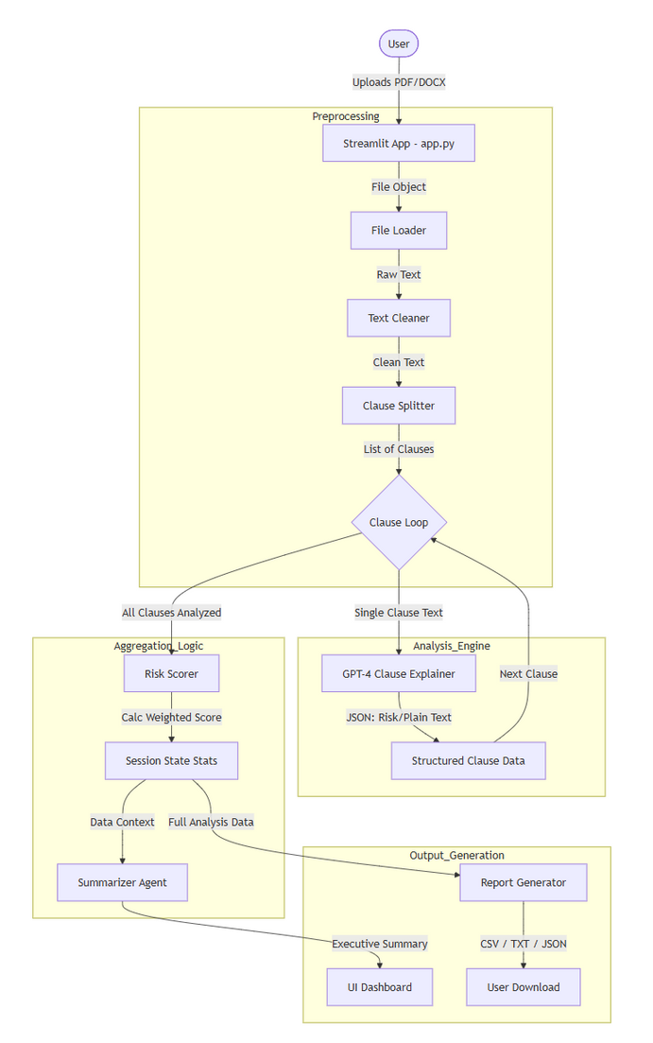
Methodology & Architecture
Understanding How Our AI Enhances Legal Processes Effortlessly
Workflow:
Ingestion: Supports PDF/DOCX via pdfplumber.
Smart Segmentation: Uses Regex & SpaCy (clause_splitter.py) to break documents into semantic chunks, not just lines.
GenAI Analysis: GPT-4 Agent (clause_explainer.py) acts as a legal expert for each chunk.
Scoring Logic: Mathematical weighting system (risk_scorer.py) assigns severity (High=15, Med=8, Low=3).

Slide 5
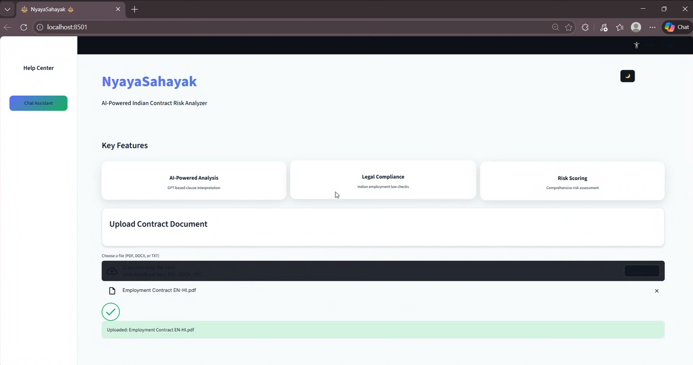
Key Features
Dynamic Risk Dashboard: Interactive Pie Charts & Bar Graphs (Plotly).
Clause Insights: Expandable cards showing "Original Text" vs. "Plain Explanation".
Audit Trail: Downloadable JSON/CSV reports for compliance.
AI Chat Assistant: Built-in sidebar chat for instant Q&A about the contract.

Slide 6

Innovation: The Clause Agent
Precision over Generality
Most tools summarize the whole PDF (losing details).
Nyaya Sahayak uses a Clause-by-Clause approach.
We isolate specific liabilities (e.g., "Termination Clause") and check them against Indian Contract Act standards.
Output: Strict JSON structure ensuring no hallucinations.

Slide 7
Tech Stack
Frontend & UI
Streamlit: Rapid UI development with secure, local session management (no external DB).
Plotly: Powers the interactive "Risk Health Meter" and dynamic charts.
Custom CSS: Professional Dark Mode aesthetic designed for reduced eye strain.
Backend & Processing
Python & Pandas: Orchestrates logic and structures raw text into analyzable DataFrames.
Regex: Custom "Clause Splitter" engine to detect complex legal numbering (e.g., 1.1, Article IV) that standard NLP misses.
AI & Intelligence
GPT-4o-mini: Selected for high legal reasoning capabilities and cost-efficiency.
Prompt Engineering: Uses "Persona-Based Prompting" (Senior Legal Consultant) to enforce strict JSON outputs and prevent hallucinations.
Data Ingestion
pdfplumber: Preserves layout and density for accurate header detection (Superior to PyPDF2).
python-docx: Robust parsing for editable Word documents.

Slide 8
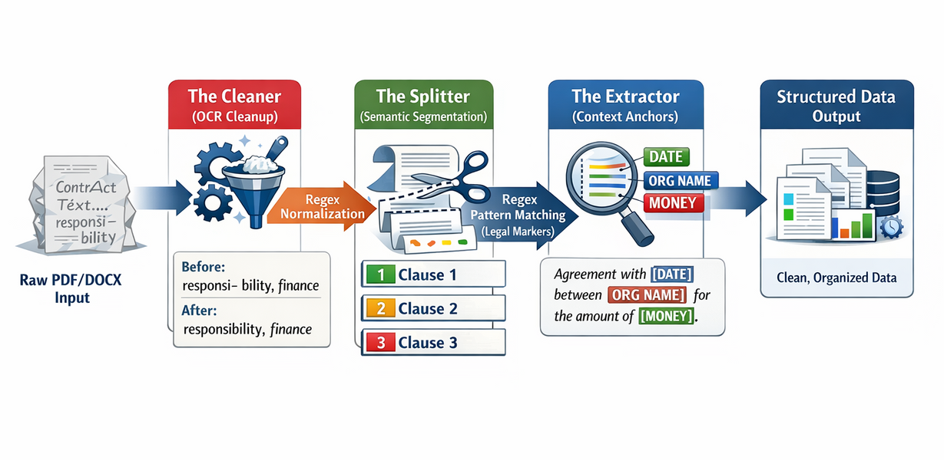
The Preprocessing Pipeline
1. OCR Cleanup & Normalization
Action: Fixes ligatures and merges broken words using regex lookaheads.
Why: Ensures clean, readable text for the AI.
2. Semantic Clause Segmentation
Action: Slices documents into atomic "Clause Chunks" using legal markers (Roman numerals, Headers).
Why: Prevents "Lost in the Middle" errors common in large PDFs.
3. Entity Extraction (NER)
Tool: SpaCy (en_core_web_sm).
Action: Extracts "Context Anchors" (Dates, Parties, Amounts) upfront to ground specific obligations.

Slide 9
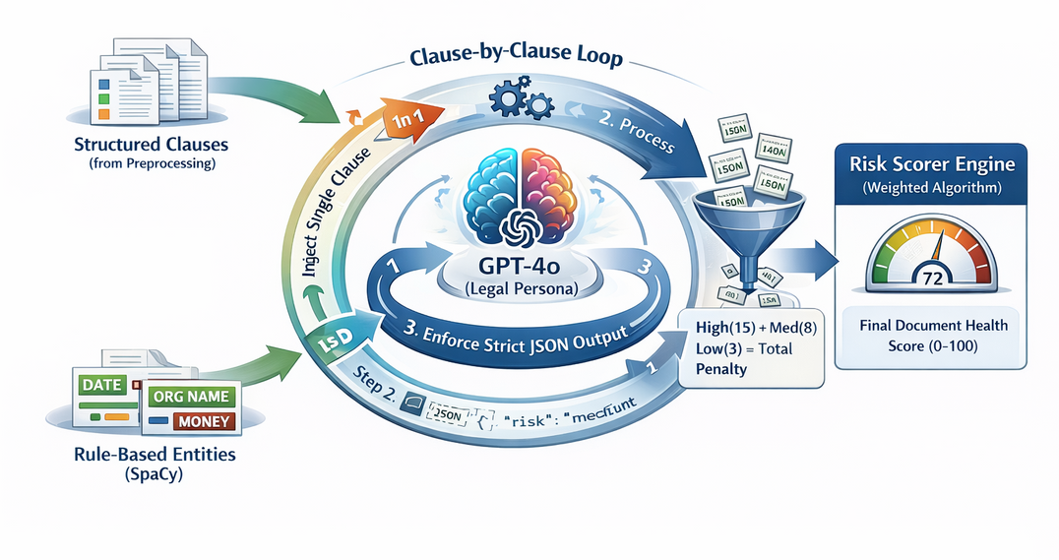
Analysis Methodology
Hybrid Architecture:
Combines Rule-Based Logic (for structure & segmentation) with GenAI (GPT-4o) (for legal reasoning & risk detection).
The "Clause-by-Clause" Loop:
Iterate: Loops through isolated clause chunks to prevent hallucinations.
Analyze: Prompts AI as a "Legal Expert" to check against Indian Contract Act standards.
Structure: Returns strict JSON data (Risk Level, Explanation, Alternative).
Scoring Logic:
Weighted Algorithm: Assigns penalties (High=15, Med=8, Low=3) based on risk severity.
Health Score: Generates a normalized 0-100 Document Safety Score for instant assessment.

Slide 10

Compliance & Impact
Tailored for the Indian Market
Compliance: Checks against Indian Labor Laws & Contract Act 1872.
Impact:
90% Time Reduction: From hours of reading to seconds of analysis.
Cost Savings: First-pass review without a lawyer.
Empowerment: Helps SMEs negotiate better terms using "Safer Alternative" suggestions.

Slide 11

Future Roadmap
From Analysis to Autonomous Legal Intelligence
Breaking literacy barriers with Voice-to-Voice interaction (speak to the AI in Hindi/Tamil/Telugu to understand your rights).
Moving beyond reading contracts to acting on them. The AI will draft email replies to counter-negotiate unfavorable terms automatically.
Integrating Indian Case Law APIs (Kanoon/Manupatra) to predict if a specific clause would actually hold up in court.
One-click connection to human lawyers for "Red Flag" clauses, creating a hybrid AI-Human safety net.

Slide 12
Conclusion
Nyaya Sahayak isn't just an analysis tool; it is the bridge between complex legislation and business aspiration, empowering every Indian SME with the legal intelligence of a top-tier firm.
Links:
https://github.com/titir232004/Contract-Analysis-Risk-Assessment-Bot

